Slide 1
Weather and Crime
Analytic Review of Weather Effect on Crime

Slide 2
Team
Kevin McCurdy
Chris Wong
Amir Afshar
Michael Montoya
Minh Huynh

Slide 3
Motivation
Hypothesis: To test human activity patterns, as measured by crime against weather and temperature. We expect crimes and temperature (and weather by proxy) to have a positive correlation.
Overall: we were satisfied with our data exploration. We discovered the following:As temperature increases, overall crime increases. Crimes most affected by weather fall into the Property or Violent category.Crime patterns fluctuate with the season, cooling off in winter and coming to a boiling point in summer.Weather events affect rate of which crimes occur.

Slide 4
Questions
Does weather affect crime incidence? Do crimes occur more often in areas experiencing extreme seasonal weather changes?
Does temperature affect crime?
What type of crime is affected the most by weather?
What contributes to crime occurrences?

Slide 5
Data Cleanup
Data collection:
The crime data was collected from their respective city’s data source through data.gov and kaggle.com.
Weather data was collected from www.weatherunderground.com
Data clean up:
The crime data was cleaned up to only retain information needed for our analysis.
The weather data needed manipulations to fields such as the date field in order to properly merge the two data sets.
Data merging:
The data set were joined by date to create a completed population by city.

Slide 6
Data Analysis
Our team wanted to standardize the two sets of crime data and have consistencies across both cities, we assigned all crimes within both cities to 1 of 5 main crime categories. Consensual, disturbance, property, violent, and white collar.
The cleaned data sets were plotted and analyzed to determine if any correlations existed

Slide 7
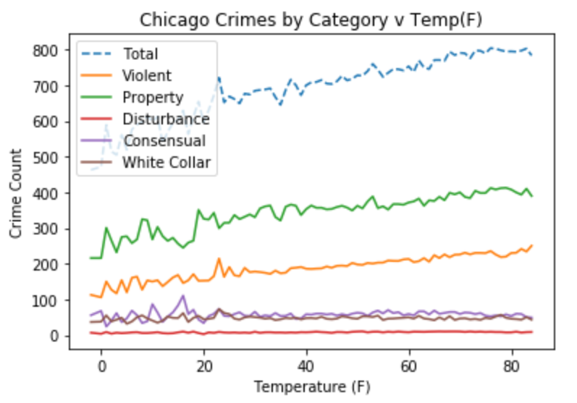
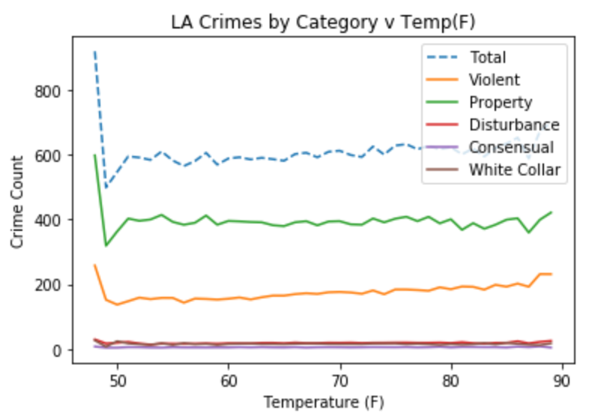
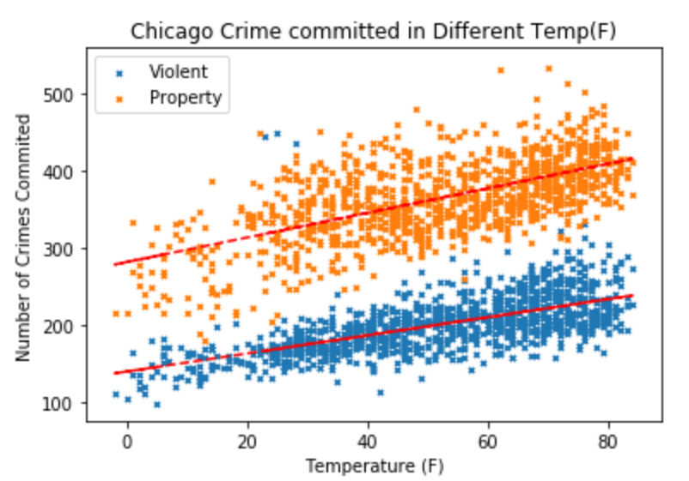
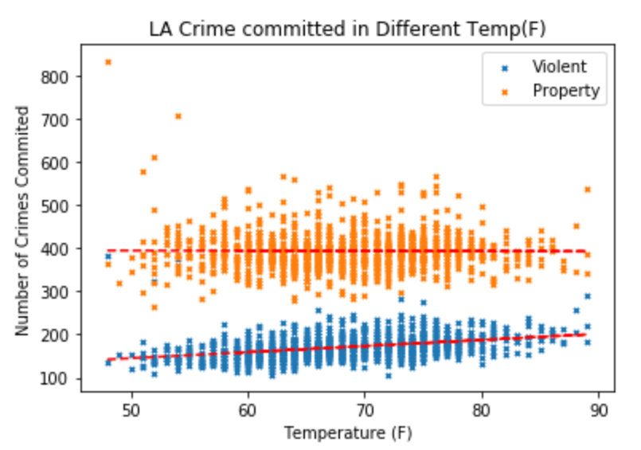
Does weather affect crime incidence? Do crimes occur more often in areas experiencing extreme seasonal weather changes?

Slide 8
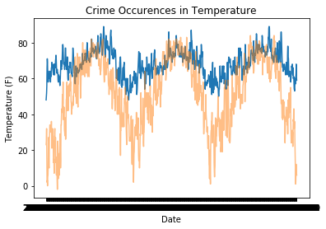
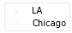
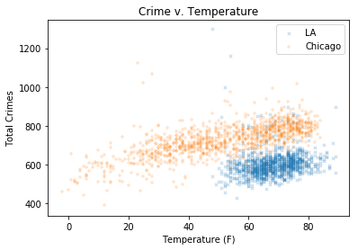
Does temperature affect crime?
2015 2016 2017

Slide 9
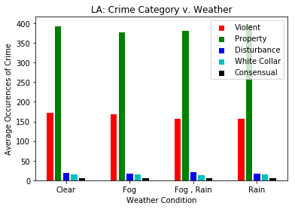
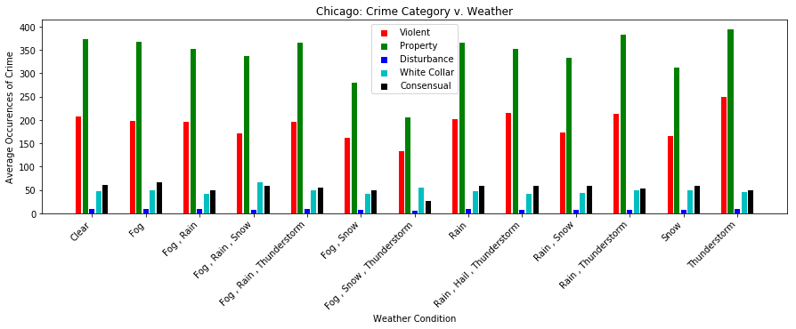
What type of crime is affected the most by weather?

Slide 10
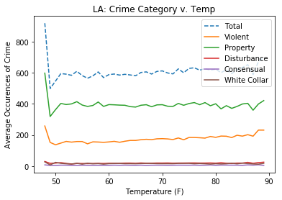
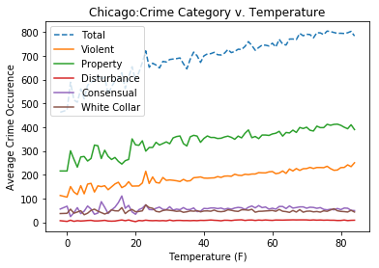
What contributes to crime occurrences?

Slide 11
Discussion
We discovered that crime patters are more readily apparent in areas with varying weather extremes, versus areas where areas where weather is relatively steady.
Overall, when weather events are consistent, crime types remain consistent.
Property and violent crimes were the most prevalent crimes in both Chicago and Los Angeles, but correlations were only visible with temperatures and not weather events.
Temperature and crime are positively correlated, up until a certain point.

Slide 12
Post Mortem
Challenges:
We experiences licensing challenges when pursuing OpenWeather API’s historical data, forcing us to pursue alternatives.
Searched the web for historical weather and found WeatherUnderground.
Chicagos Data File was initially too large to work with (over 1.5 GB as a CSV).
Opened CSV in Pandas and performed several .drop to eliminate excess data.
Crime: Primary Type between LA and Chicago did not sync. Research categories to bin each Crime Type.
Resulted in 5 Crime types: White Collar, Property, Disturbance, Violent, and Consensual.
Additional Questions:
What is the rate of Crime Occurrences inside versus outside?
Controlling for temperatures indoors, would crime occur at the same rate?
Does city diversity contribute to Crime Rate?
Averaging total crimes against total police recruits for each year?

Slide 13
Questions
Questions?

Slide 14
The End

